Slide 1
Testing/Validation Activities Unit-IV
Prepared by: Neha Tripathi

Slide 2
INTEGRATION TESTING
Lecture-1

Slide 3
INTEGRATION TESTING
The primary objective of integration testing is to test the module interfaces, i.e. there are no errors in the parameter passing, when one module invokes another module.
During integration testing, different modules of a system are integrated in a planned manner using an integration plan.
The integration plan specifies the steps and the order in which modules are combined to realize the full system.
After each integration step, the partially integrated system is tested.
Integration testing focuses on bugs caused by interfacing between the modules while integrating them.

Slide 4
continue….
Thus, integration testing is necessary for the following reasons:
Integration testing exposes inconsistency between the modules such as improper call or return sequences.
Data can be lost across an interface.
One module when combined with another module may not give the desired result.
Data types and their valid ranges may mismatch between the modules.

Slide 5
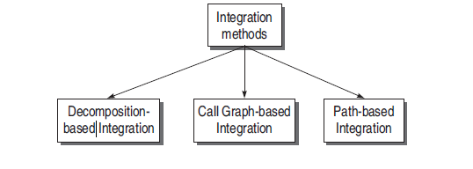
Approaches of Integration Testing

Slide 6
DECOMPOSITION-BASED INTEGRATION
The idea for this type of integration is based on the decomposition of design into functional components or modules.
The functional decomposition is shown as a tree. In the tree designed for decomposition-based integration, the nodes represent the modules present in the system and the links/edges between the two modules represent the calling sequence. The nodes on the last level in the tree are leaf nodes.
In the tree structure shown in next Fig, module A is linked to three subordinate modules, B, C, and D. It means that module A calls modules, B, C, and D.
All integration testing methods in the decomposition-based integration assume that all the modules have been unit tested in isolation.
Thus, with the decomposition-based integration, we want to test the interfaces among separately tested modules.

Slide 7
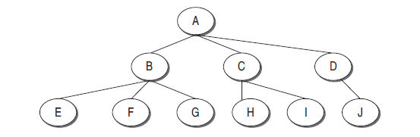
Fig.: Decomposition Tree

Slide 8
Classification
Integration testing methods are classified into two categories:
(a) non-incremental and (b) incremental.
Non-Incremental Integration Testing:In this type of testing, either all untested modules are combined together and then tested or unit tested modules are combined together. It is also known as Big-Bang integration testing.
Big-Bang method cannot be due to adopted practically:
- Big-Bang requires more work. According to the Big-Bang theory, if all unit tested modules are integrated in this example(next slide), then for unit testing of all the modules independently, we require four drivers and seven stubs. This count will grow according to the size of the system.
- Actual modules are not interfaced directly until the end of the software system.
- It will be difficult to localize the errors since the exact location of bugs cannot be found easily.

Slide 9
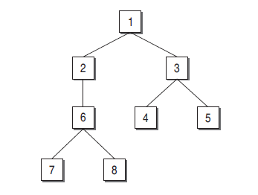
For example, consider the following hierarchy of a software system.

Slide 10
continue…
Incremental Integration Testing: In this type, you start with one module and unit test it. Then combine the module which has to be merged with it and perform test on both the modules . In this way, incrementally keep on adding the modules and test the recent environment. Thus, an integrated tested software system is achieved.
Incremental integration testing is beneficial for the following reasons:
- Incremental approach does not require many drivers and stubs.
- Interfacing errors are uncovered earlier.
- It is easy to localize the errors since modules are combined one by one.
-The first suspect is the recently added module. Thus, debugging becomes easy.
- Incremental testing is a more thorough testing. Consider the example previous Fig. If we are testing module 6, then although module 1 and 2 have been tested previously, they will get the chance to be tested again and again. This gives the modules more exposure to the probable bugs by the time the last module in the system is tested.

Slide 11
Types of Incremental Integration Testing
Incremental integration testing is divided into two categories.
- Top-down Integration Testing
- Depth first integration
- Breadth first integration
- Bottom-up Integration Testing

Slide 12
Top-down Integration Testing
The strategy in top-down integration is to look at the design hierarchy from top to bottom. Start with the high-level modules and move downward through the design hierarchy.
Modules subordinate to the top module are integrated in the following two ways:
Depth first integration: In this type, all modules on a major control path of the design hierarchy are integrated first. In the example shown in previous Fig. modules 1, 2, 6, 7/8 will be integrated first. Next, modules 1, 3, 4/5 will be integrated.
Breadth first integration: In this type, all modules directly subordinate at each level, moving across the design hierarchy horizontally, are integrated first. In the example shown in previous Fig. , modules 2 and 3 will be integrated first. Next, modules 6, 4, and 5 will be integrated. Modules 7 and 8 will be integrated last.

Slide 13
Top-Down Integration Procedure
1. Start with the top or initial module in the software. Substitute the stubs for all the subordinate modules of top module. Test the top module.
2. After testing the top module, stubs are replaced one at a time with the actual modules for integration.
3. Perform testing on this recent integrate environment.
4. Regression testing may be conducted to ensure that new errors have not appeared.
5. Repeat steps 2–4 for the whole design hierarchy.

Slide 14
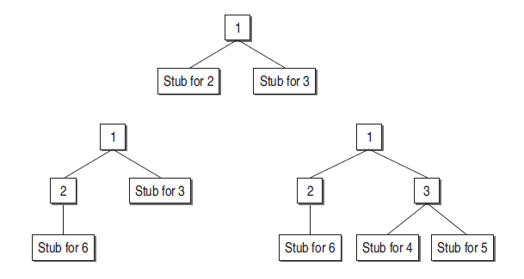
Continue….

Slide 15
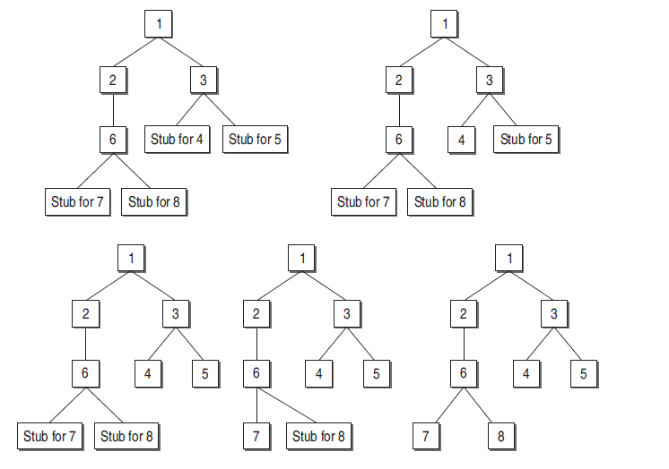
Continue….

Slide 16
Drawbacks of top-down integration testing
1. Stubs must be prepared as required for testing one module.
2. Stubs are often more complicated than they first appear.
3. Before the I/O functions are added, the representation of test cases in stubs can be difficult.

Slide 17
Bottom-up Integration Testing
The bottom-up strategy begins with the terminal or modules at the lowest level in the software structure. After testing these modules, they are integrated and tested moving from bottom to top level. Since the processing required for modules subordinate to a given level is always available, stubs are not required in this strategy.
Unlike top-down strategy, this strategy does not require the architectural design of the system to be complete. Thus, bottom-up integration can be performed at an early stage in the developmental process.
It may be used where the system reuses and modifies components from other systems.

Slide 18
Bottom-up integration procedure
1. Start with the lowest level modules in the design hierarchy. These are the modules from which no other module is being called.
2. Look for the super-ordinate module which calls the module selected in step 1. Design the driver module for this super-ordinate module.
3. Test the module selected in step1 with the driver designed in step 2.
4. The next module to be tested is any module whose subordinate modules (the modules it calls) have all been tested.
5. Repeat steps 2 to 5 and move up in the design hierarchy.
6. Whenever, the actual modules are available, replace stubs and drivers with the actual one and test again.

Slide 19
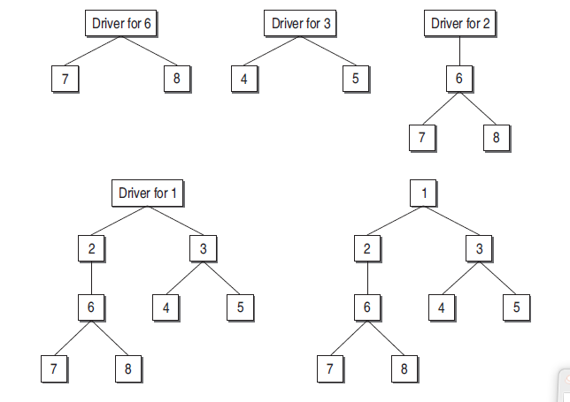
Continue….

Slide 20
Drawbacks of bottom up integration
This type of integration is useful for integrating object-oriented systems, real-time systems, and systems with strict performance requirements.
Bottom up integration has the disadvantage that the software as a whole does not exist until the last module is added.
It is also not an optimal strategy for functionally decomposed systems, as it tests the most important subsystem last.

Slide 21
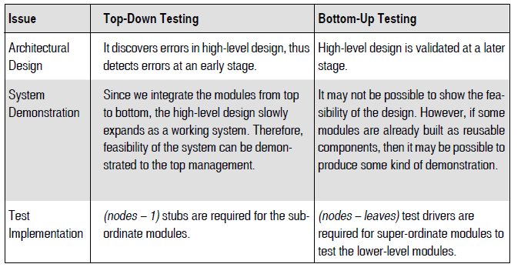
Comparison between Top-Down and Bottom-Up Integration Testing

Slide 22
Practical Approach for Integration Testing
Sandwich integration testing:
- It integrates both top-down and bottom-up techniques.
- In general, sandwich testing strategy that uses top-down tests for upper levels of the program structure with bottom-up tests for subordinate levels is the best compromise.
- The practical approach for adopting sandwich testing is driven by the following factors:
- Priority
- Availability

Slide 23
Pros and Cons of Decomposition-Based Integration
Decomposition-based integration techniques are better for monitoring the progress of integration testing along the decomposition tree. If there is failure in this integration, the first suspect goes to the recently added module, as the modules are integrated one by one either in top-down or bottom-up sequence. Thus, debugging is easy in decomposition-based integration.
However, there is more effort required in this type of integration, as stubs and drivers are needed for testing. Drivers are more complicated to design as compared to stubs. The integration testing effort is computed as the number of test sessions. A test session is one set of test cases for a specific configuration.
The total number of test sessions in a decomposition-based integration is
computed as:
Number of test sessions = nodes – leaves + edges

Slide 24
Integration Testing
Lecture-2

Slide 25
CALL GRAPH-BASED INTEGRATION
It is assumed that integration testing detects structural bugs. In order to detect some behavioural bugs, we refine the functional decomposition tree into a form of module calling graph, to perform behavioural testing at the integration level. This is done with the help of a call graph.
A call graph is a directed graph, wherein the nodes are either modules or units, and a directed edge from one node to another means one module has called another module.
The call graph can be captured in a matrix form which is known as the adjacency matrix.
For eg, in next Fig., which is a call graph of a hypothetical program. The figure shows how one unit calls another. Its corresponding adjacency matrix is also represented. This matrix may help the testers a lot.

Slide 26
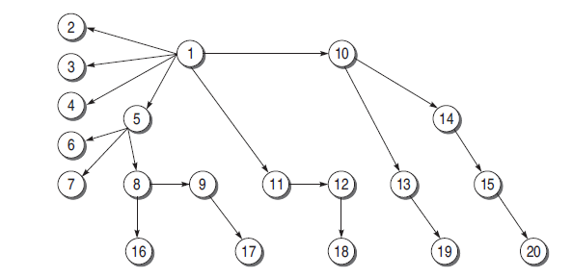
Example call graph

Slide 27
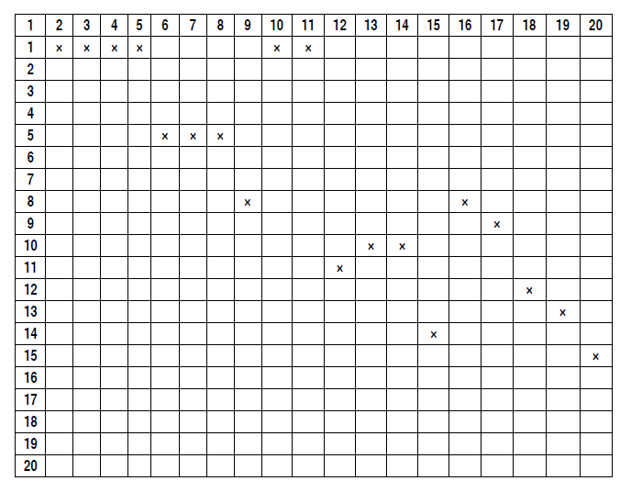
Adjacency matrix

Slide 28
continue….
The call graph shown in the Fig. can be used as a basis for integration testing.
The idea behind using a call graph for integration testing is to avoid the efforts made in developing the stubs and drivers. If we know the calling sequence, and if we wait for the called or calling function, if not ready, then call graph-based integration can be used.
There are two types of integration testing based on call graph which are discussed next.
- Pair-wise Integration
- Neighbourhood Integration

Slide 29
Pair-wise Integration
If we consider only one pair of calling and called modules, then we can make a set of pairs for all such modules, as shown in the Fig. , for pairs 1–10 and 1–11.
The resulting set will be the total test sessions which will be equal to the sum of all edges in the call graph.
For example, in the call graph shown in Fig., the number of test sessions is 19 which is equal to the number of edges in the call graph.

Slide 30
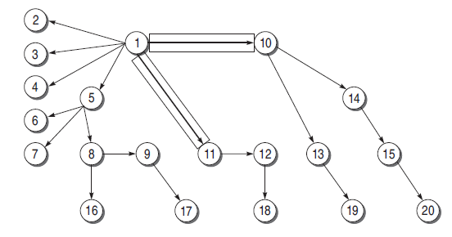
Pair-wise integration

Slide 31
Neighbourhood Integration
There is not much reduction in the total number of test sessions in pair-wise integration as compared to decomposition-based integration.
If we consider the neighbourhoods of a node in the call graph, then the number of test sessions may reduce.
The neighbourhood for a node is the immediate predecessor as well as the immediate successor nodes.
The neighbourhood of a node, thus, can be defined as the set of nodes that are one edge away from the given node.
The neighbourhoods of each node in the given call graph is represented in the next table.

Slide 32
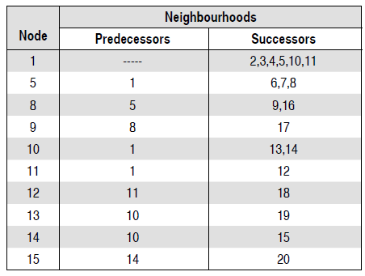
Neighbourhood integration details

Slide 33
continue….
The total test sessions in neighbourhood integration can be calculated as:
Neighbourhoods = nodes – sink nodes
= 20 – 10
= 10
where sink node is an instruction in a module at which the execution terminates.

Slide 34
PATH-BASED INTEGRATION
In a call graph, when a module or unit executes, some path of source instructions is also executed. And it may be possible that in that path execution, there may be a call to another unit.
At that point, the control is transferred from the calling unit to the called unit. This passing of control from one unit to another unit is necessary for integration testing.
Also, there should be information within the module regarding instructions that call the module or return to the module. This must be tested at the time of integration.
It can be done with the help of path-based integration defined by Paul C. Jorgenson.
We need to understand the following definitions for path-based integration.

Slide 35
continue…..
Source node It is an instruction in the module at which the execution starts or resumes. The nodes where the control is being transferred after calling the module are also source nodes.
Sink node It is an instruction in a module at which the execution terminates. The nodes from which the control is transferred are also sink nodes.
Module execution path ( MEP) It is a path consisting of a set of executable statements within a module like in a flow graph.
Message When the control from one unit is transferred to another unit, then the programming language mechanism used to do this is known as a message. For example, when there is a function call, then it is a message from one unit (where the call is mentioned; caller module) to another unit (the unit which is being called).

Slide 36
continue…..
MM-path It is a path consisting of MEPs and messages. The path shows the sequence of executable statements; it also crosses the boundary of a unit when a message is followed to call another unit. In other words, MM-path is a set of MEPs and transfer of control among different units in the form of messages.
MM-path graph It can be defined as an extended flow graph where nodes are MEPs and edges are messages. It returns from the last called unit to the first unit where the call was made. In this graph, messages are highlighted with thick lines.
Now let us see the concept of path-based integration with the help of an example. Next fig. shows the MM-path as a darken line. The details regarding the example units shown in Fig. is given in the corresponding Table .

Slide 37
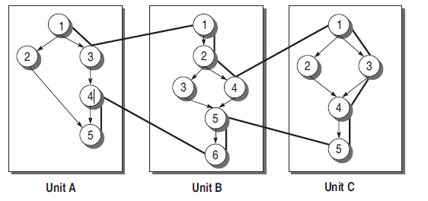
MM-path

Slide 38
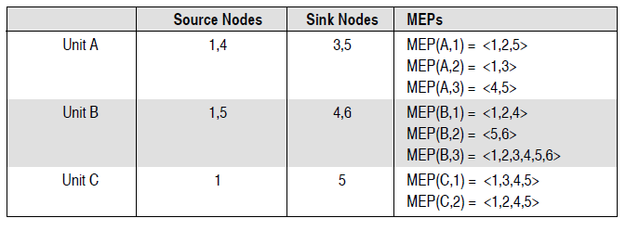
MM-path details

Slide 39
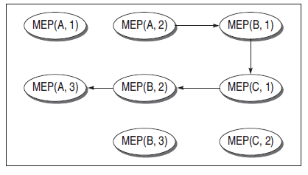
MEP graph

